Slide 1
Business acceleration services & EIC Community

Slide 2

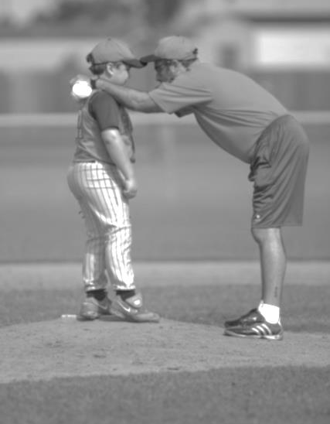

Smart Money!
Equity Free Funding
World-Class Coaching
Business Acceleration Services & Community
Notes:
The goal of the EIC Business Acceleration Services is to offer the companies non-monetary business development support. Via exclusively designed matching events and networking opportunities, the EIC facilitates further access to private investment, and opens doors to international business partners, e.g. distributors, suppliers or potential clients.
The outcome can create different forms of collaboration like mentoring, proof of concept, venture client or sales. At the same time, those services create manifold peer-led learning opportunities among the companies themselves, actively supported via a dedicated EIC Community space.
We strongly believe: preparation is key! Selected EIC business coaches prepare each company individually for an effective pitch and bilateral meetings working out their specific value proposition.

Slide 3
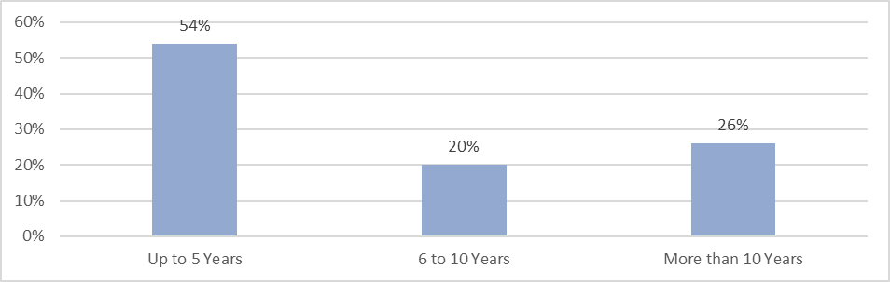
Size of EIC Accelerator portfolio companies

Slide 4
Business acceleration services for YOU!
Accessible during & after grant!
Based on your needs!

Slide 5
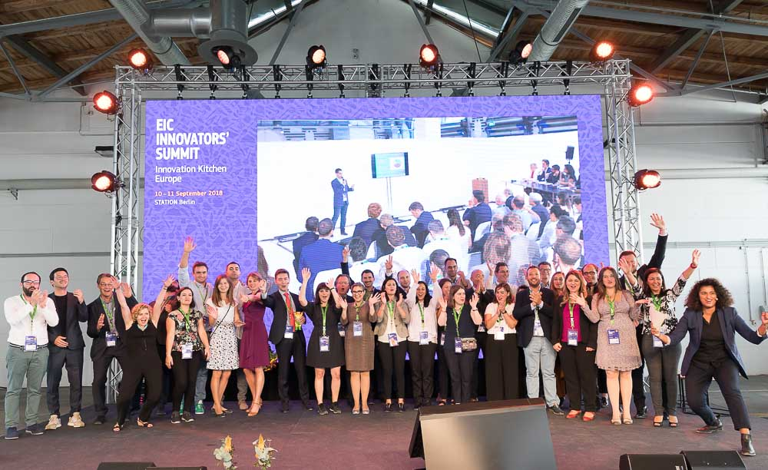
Our value proposition to you

Slide 6



What we are doing so far…
Events with corporate and finance partners (Corporate Days & Pitching & 1to1 meetings)
Epitching events & Matching with investors
Peer2peer learning: EIC Community
Notes:
As a first result, up to 25% of participating companies are closing follow-up deals after the EIC events.
7500 EIC Community members
40+ networking events per year
650 pitching SMEs
700 B2B meetings
30-75% of SMEs having follow up discussions
5-25% of SMEs having follow-up deals

Slide 7
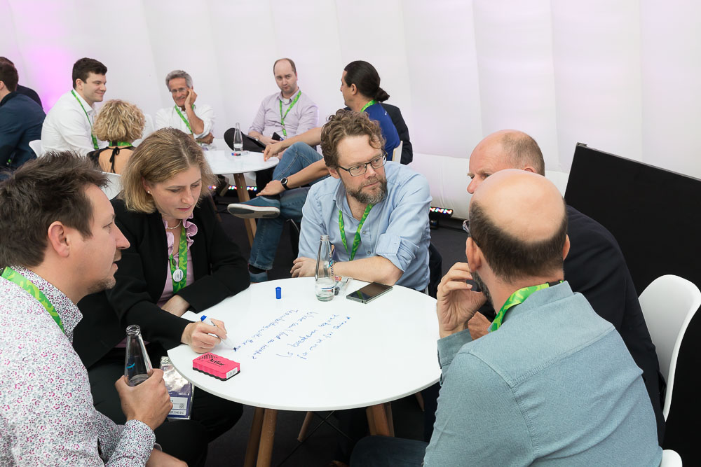
What will soon come on top?
Access to public & private procurers
Bootcamp for early stage/researchers
Visit to European innovation hubs
Peer2peer learning workshop(s)
EIC hub in Brussels

Slide 8
How to find the service calendar & how to apply?

Slide 9
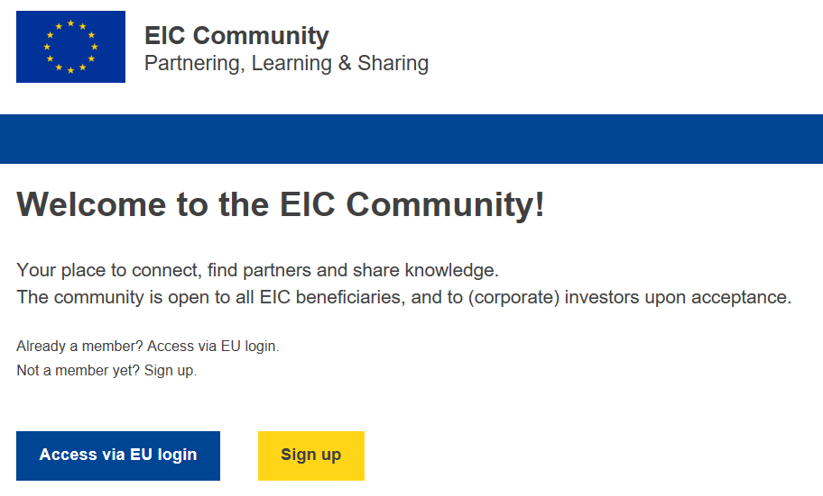
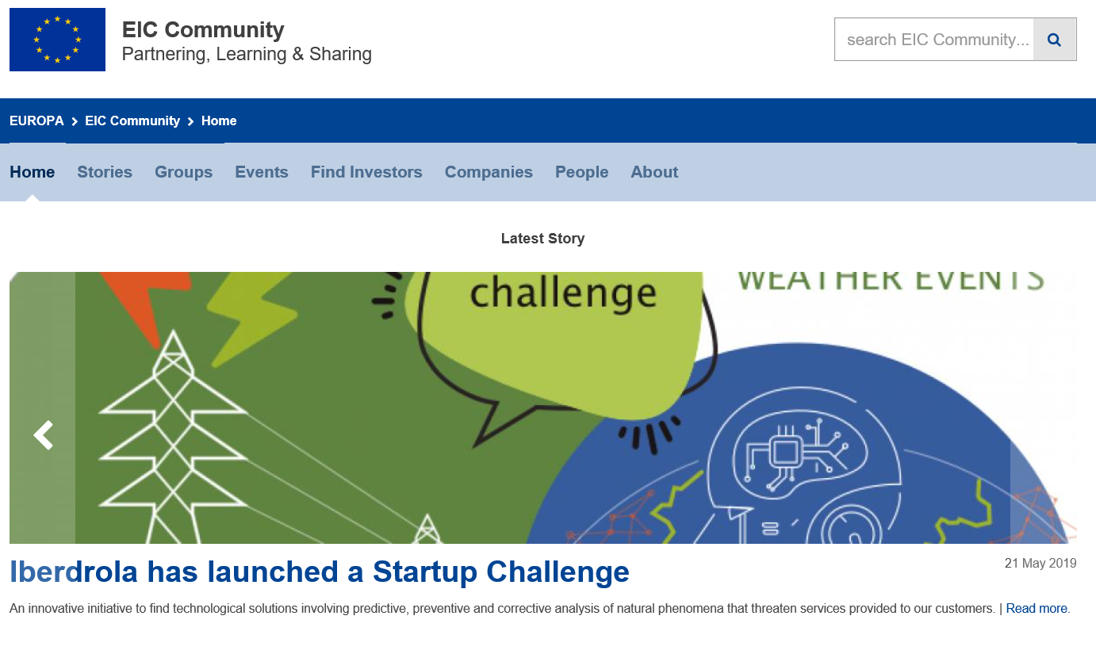

EIC business Community https://community-smei.easme-web.eu/

Slide 10
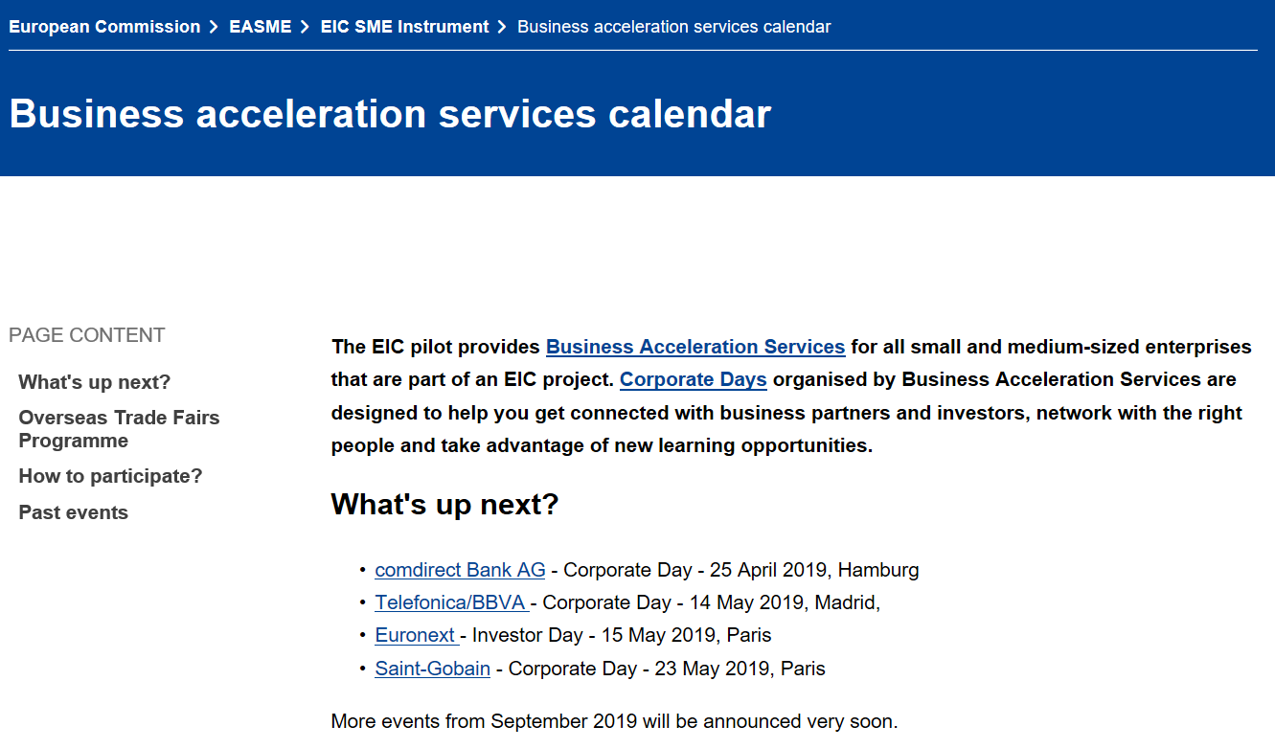
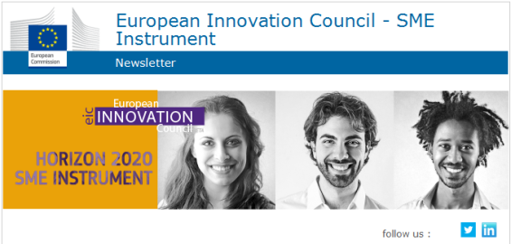
EASME Website https://ec.europa.eu/easme/en/eic-sme-instrument
Subscribe to our NEWSLETTER!

Slide 11

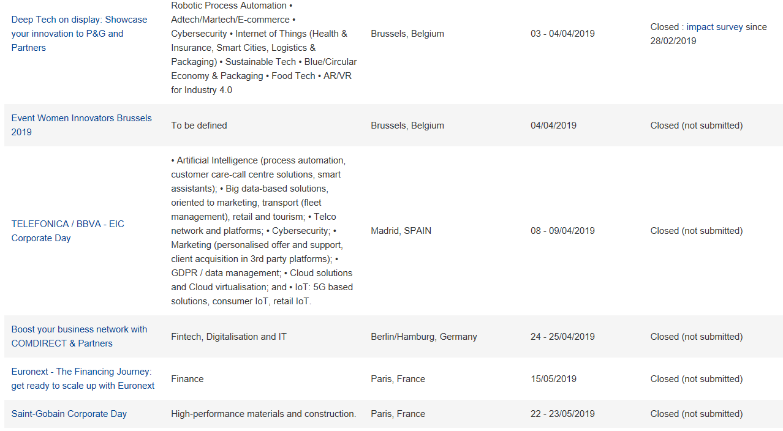
How to apply?

Slide 12
EIC Business Community
Platform
Notes:
It is a great pleasure to be here today in this great location in this great city.
Innovation is central to Europe's ability to generate new jobs and economic growth in the coming years and to tackle major challenges that society is facing including sustainability, climate change, the health of ageing populations, energy and food security. Without productivity growth, our societies cannot raise living standards. Innovation, in all its forms, is the main source of productivity growth in advanced economies and it accounts for an estimated 60% to 80% of total economic growth in recent years. We will therefore need to continue to invest in research and innovation (R&I) in order to drive prosperity and compete with other major economies.

Slide 13

The EIC Business Community
www.community-smei.easme-web.eu
The EIC Business Community is a comprehensive online platform designed to connect companies, investors and partners involved with the EIC pilot.
What can you find on the EIC Community?
Get support from peers and the SME’s eco-system, overcoming physical distances
Share experiences and knowledge
Co-create knowledge
Explore business opportunities and expand your business network
Self-organise online events and learning opportunities
Get access to Business Acceleration Services, such as matching partners and investors
May 2018
Notes:
What:
The EIC Community already existed offline. With this platform we want to boost connections and foster communication by creating a shared knowledge base and a virtual meeting-place where SMEs can connect and leverage potential businesses partnerships.
Members:
EIC-funded companies (Fast Track to Innovation, FET Open, SME Instrument, Horizon Prizes)
EIC extended community (POs, Coaches, KAMs, Jury Members, …)

Slide 14
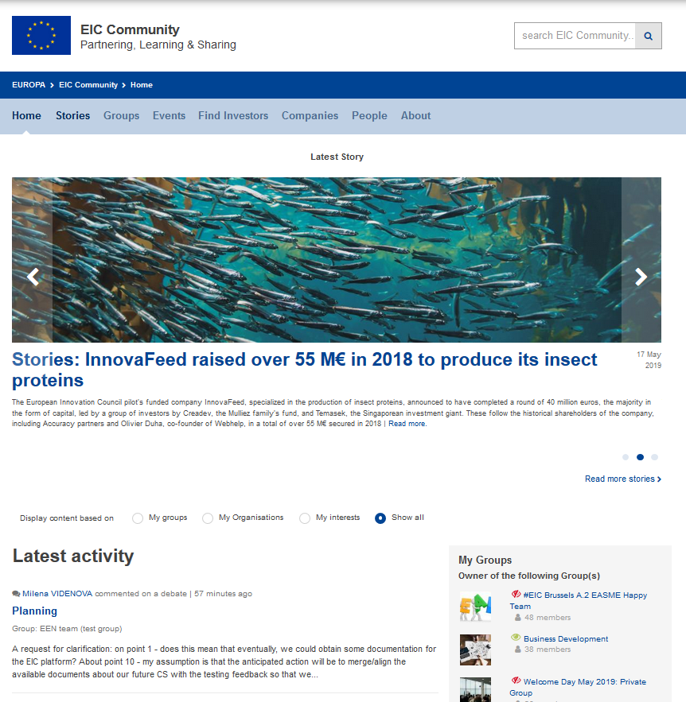

Stay up to date with news & stories
Notes:
What:
See highlights of the most relevant news, impact stories, open calls for events and others.
Goal:
Stay up to date

Slide 15
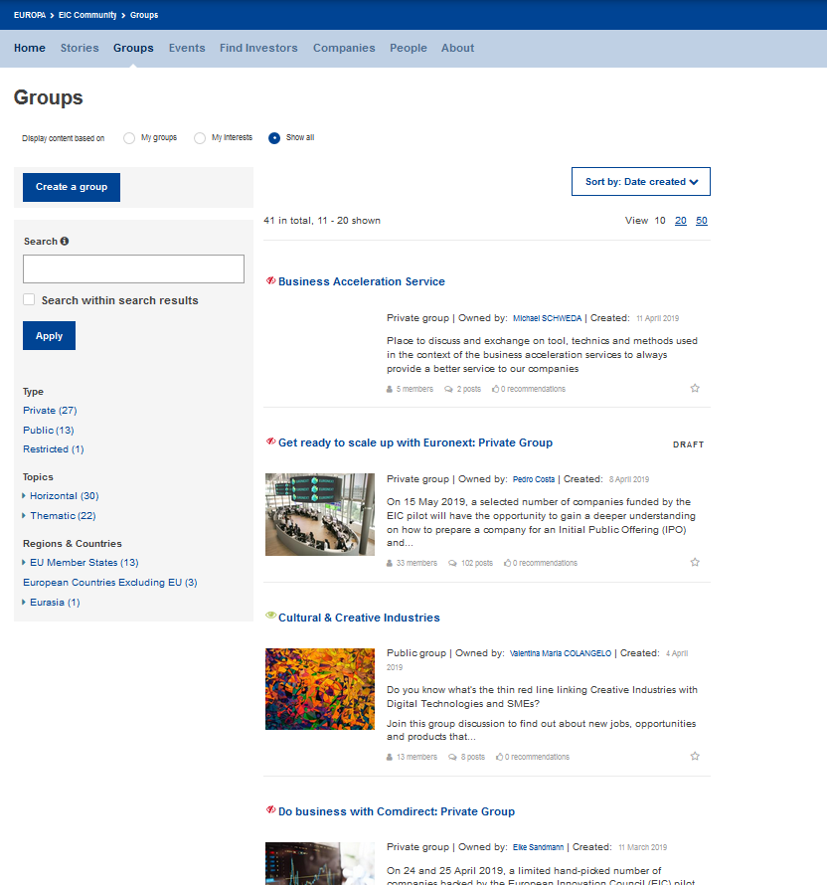

Connect & share in groups
Notes:
What:
Find relevant information by a thematic or horizontal taxonomy of all areas of the EIC Community in one page.
All the content posted under a specific topic can be found on one page.
Don’t miss out on any information!
Goal:
promote easier way to search information and share knowledge.

Slide 16
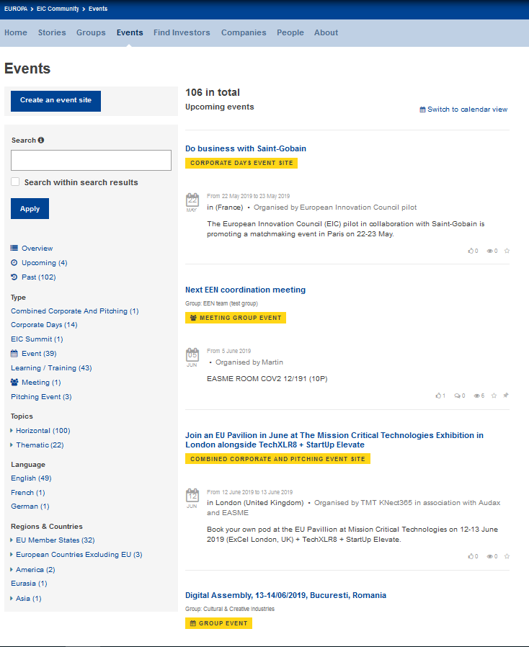

Events
Notes:
What:
A list of curated Events promoted by the EIC Community, or events directly promoted by the EIC Community members in Groups.
Goal:
centralized information on events relevant to the EIC Community members:
Academy Workshops
Pitching Events
Corporate Days
Welcome Days
EIC Summit
Overseas Trade Fairs

Slide 17
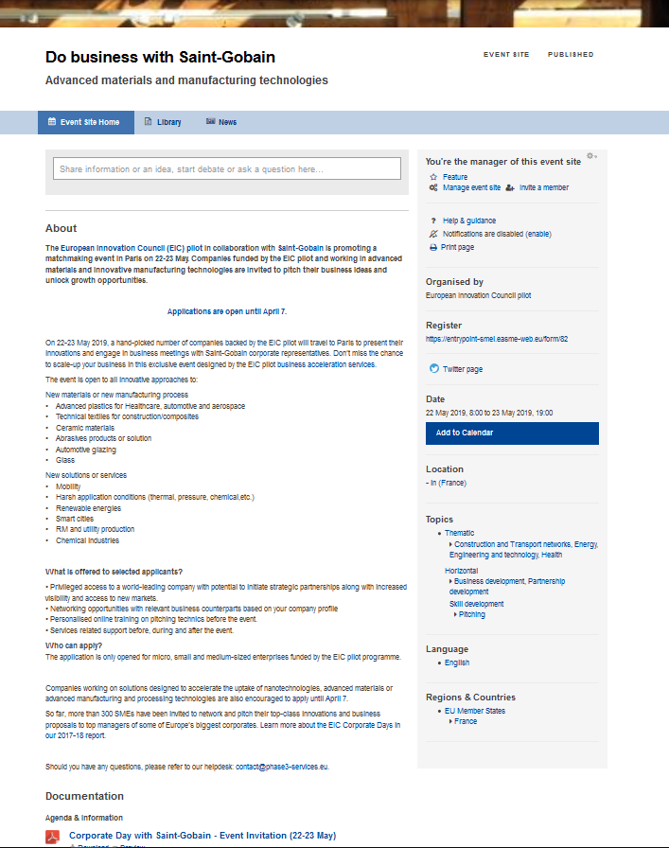
Events
Notes:
Members can find here all the information related to an event:
i. Agenda & Information
ii. Event updates
iii. Photo Albums
iv. Presentations & Documents

Slide 18
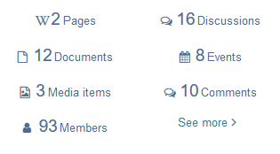
You want to find an investor? Or to invest?
Think: “Financial Group” and “ScaleUp EU”
https://community-smei.easme-web.eu/financial-development
scaleup-smei.easme-web.eu
ScaleUp EU is a major part of the new EIC Community platform. It’s an online matching tool designed to connect investors and SME companies funded by the EIC pilot.
What can you do on ScaleUP EU?
Access an automatic matchmaking tool based on investor and company profiles
Visualize key information to assess potential partners and launch contacts via the platform
Access a tool that assures confidentiality and mutual trust building, by allowing public or an anonymous profiles

Slide 19

Showcase your company
Notes:
What:
Organisations have a page profile to share relevant information about their activity. It’s the organisation job to feed the information and keep it relevant:
i. About us
ii. News
iii. Media
iv. Events
v. Team
Goal:
Improve business relations.

Slide 20
Stay connected!

Slide 21
Governments as Clients
Public procurement
Bertrand Wert

Slide 22


Governments as clients: the opportunities of public procurement
Every year, over 250 000 public authorities in the EU spend around 14% of GDP (+/- €1.3 trillion per year) on the purchase of services, works and supplies
In many sectors such as energy, transport, waste management, social protection and the provision of health or education services, public authorities are the principal buyers
Future actions
Dedicated group on EIC Business community
Onboarding of private and public procurers interested in working with innovators
Webinars for SMEs: ‘Procurement skills for SMEs’
Market Consultation bring together public procurers and suppliers from all over Europe to discuss procurement needs and solutions
Online innovation brokerage process – Solution Space for needs and ideas
Partnerships with public procurer associations

Slide 23
Welcome Days
Thursday 23/05 AM Workshops
Bertrand Wert

Slide 24
Info on tomorrow’s workshops 10h-10h45
Scale-up EU: the matching tool to look out for investors: Andrea
Doing business with large corporates. Manuel
How to sell to public (and private) buyers? Bertrand
4. Get paid faster by avoiding these errors: Isabel

